Slide 1
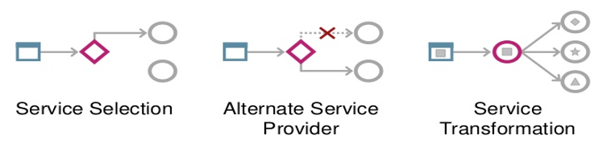
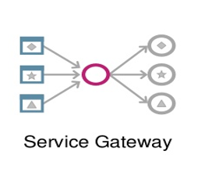
Service Gateway Lunch & Learn
Using the Service Gateway to Support the Nationwide Platform

Slide 2
Service Gateway
NEM Challenges

Slide 3
NEM Challenges
Problem | Gateway addresses this by:
Migration and Availability - staged cut-over & roll out | Dynamic routing to different service versions (Service Selection/Gateway)
Switching Endpoints During Test | Dynamic routing to SoR or stub (Service Selection/Gateway)
Managing Service Outages | Dynamic routing on service failure to alternate SoR or stub (Alternate Service Provider/Gateway)
Version Proliferation | Dynamic routing & transformation to higher service versions (Service Selection/Transformation/Gateway)
Environment Contention – need to share an environment across projects | Dynamic routing to different service versions (Service Selection/Gateway)
Onus on Consumer to Change | Dynamic routing & transformation to higher service versions (Service Selection/Transformation/Gateway)

Slide 4
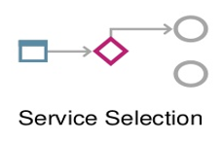
Migration and Availability
Problem - Staged Cut-Over & Roll Out
The implementation approach for SO and future programmes requires a period of co-existence in production of old and new. The switch from old to new needs to be managed, controlled, automated, and often gradual based on parameters such as channel, customer type etc. The requirement is zero downtime.
Approach using Gateway - Supported
The service routing gateway looks up service endpoints by accessing an endpoint cache based on parameters. e.g. virtual environment, channel identifier, common parameters in the request message, time or randomised.
Endpoint caching used for performance.

Slide 5

Staged Cut-Over & Roll Out Continued
Problem - Canary in the coal mine.
We need to prove staged cut-over in production with a selected set of consumers (canary group e.g. friends and family).
Solution - Dynamic routing of traffic within the deployed runtime.
Operations staff have the ability to direct a proportion of consumer traffic across different provider endpoints, to facilitate production cut-over testing

Slide 6
Switching End Points During Tests
Problem
In many test environments the tests can call either a stubbed end point or a real endpoint. The test strategy would benefit from a system where a tester can quickly decide whether to use a stubbed endpoint or a real endpoint without relying on redeployments.
Approach using Gateway - Supported
Building on the endpoint look up described earlier, we could extend this to support multiple endpoints per environment. Marking endpoints as either offline or online.
With the current design if a stubbed endpoint needs to be used, we can replace the real endpoint with the stubbed via a simple database update; which forces a cache reset.

Slide 7
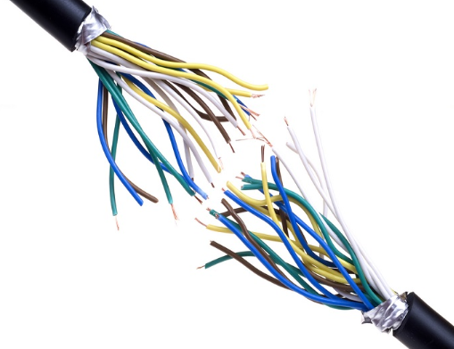
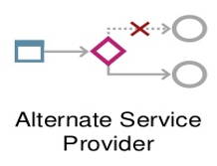
Managing Service Outages
Problem
We need a mechanism for supporting planned and unplanned service outages in production.
Approach using Gateway – Not Supported Yet
Automatic dynamic routing of traffic within the deployed runtime.
Service gateway has the ability to flip/flop consumer traffic across different provider endpoints to cope with service outages.
Here we could blend the circuit breaker design pattern into the gateway.

Slide 8
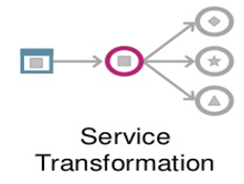
Version Proliferation
The NEM versioning policy aims to reduce service proliferation, however…
The number of services will still grow faster than necessary, because of:
The need to mitigate otherwise required regression tests
The lack of a limit to non-compatible interface changes that may be applied to any service operation
The mitigation of environment unavailability through versioning – Partially Supported
The consequences are:
Increased deployment complexity
Increased hardware utilisation
Increased support costs
Increased cost of change

Slide 9
Transformation Example from SO2 MCP FG2
The “Retrieve Product Details” (RPD) operation, within the Product Portfolio Maintenance v2 (PPMv2) service group, required a new field to be returned. This required a version 3 of the service.
Transform Schema v3.0 to Schema 2.0 (e.g. by removing fields)
PPMv2.0.RPIR
RPD
Gateway
PPMv3.0.RPD
PPMv2.0.RPIRS
Operation | schema Version | virtual Environment | Route to: | Transformation
RPD | V3.0 | SO2FG2 | RPDv3.0 | n/a
RPD | V2.0 | SO2FG1 | RPDv3.0 | Response from V3.0 to V2.0

Slide 10
Environment Contention
Problem
When two streams need to deploy their different minor versions of the same service operation in the same environment, this can get very complex e.g.
Release A needs to test that Service X 1.0 can call Service Z 1.0
Release B at the same time needs to test that Service X 1.0 can call Service Z 1.1
Approach using Gateway - Supported
Building on the endpoint look up described earlier, we could extend this to support multiple endpoints per environment (virtual environment).

Slide 11
Environment Contention: Pre EM2 Day2
Months
0
1
2
3
4
5
DEV
ST
SIT
UAT
PRD
V1.0
Chronological
Evolution
(months)
DEV
ST
SIT
UAT
PRD
V1.1
DEV
ST
SIT
UAT
PRD
V2.0
V1.1 reaches UAT
PF
DEV1
ST1
SIT1
UAT
PRD
DEV2
ST2
SIT2

Slide 12
Routing Example One from SO2 MCP
Scenario: ADAv2 changed in both SO2 FG2 and SO2 FG3. Some of the services it called changed (e.g. eligibility). We needed to support both versions in parallel in SIT. Normally this would require an ADA version 3. This would be visible to consumers, and impacts them.
Message
Operation: ADA
VE: SO2 MCP FG3
End-point: ADAv2.2
ADAv2.1
ADA
Gateway
ADAv2.2
Operation | schema Version | virtualEnvironment | Route to:
ADA | V2.2 | SO2FG3 | ADAv2.2
ADA | V2.1 | SO2FG2 | ADAv2.1

Slide 13
Routing Example Two from SO2 MCP
Scenario: ADAv2 may in turn call the VPE service which also changed from FG2 to FG3. Without having to change ADAv2, the correct version can be called based on the virtualEnvironment parameter.
Message
Operation: VPE
VE: SO2 MCP FG3
End-point: VPEv1.2
VPEv1.1
VPE
Gateway
VPEv1.2
Operation | schema Version | virtualEnvironment | Route to:
VPE | * | SO2FG3 | VPEv1.2
VPE | * | SO2FG2 | VPEv1.1

Slide 14
Environment Contention: Post EM2 Day2
DEV
ST
SIT
UAT
PRD
V1.0
Chronological
Evolution
(months)
DEV
ST
SIT
UAT
PRD
V1.1
DEV
ST
SIT
UAT
PRD
V2.0
V1.1 goes live
V1.1 reaches UAT
PF
DEV
ST
SIT
UAT
PRD
Dynamic Routing

Slide 15
Consumer onus to change – Why?
On support window expiry, a service instance is sunset. At this point its set of consumers are forced to:
Uplift (migrate) to the latest variant of the service; and
Undergo a regression test cycle
Issues:
Reduced flexibility: ability to triage the set of service instances is limited by agreed support cover and the ability to schedule consumer uplifts into plan.
Remaining consumers must all be uplifted together at sunset end. At this point they are required to migrate across wide functional gaps i.e. from a very old to the newest service version.
Not Supported Yet

Slide 16
Onus on Consumer to Change: Pre EM2 Day2
Chronological Evolution
(months)
Service Provider A
Months
0
12
24
36
48
60
72
V1.0
V1.0
V1.1
V1.1
V2.0
V2.0
Consumer B
Consumer C
Consumer D
105
75
30
90
180
Total Unit Cost:
45
Consumer E
Not
Affected
Regression
Test
Consumer
Modify
& Test
Consumer
Consumer F
Consumer G
Unit Activity Costs: 0 5 15

Slide 17
Consumer onus to change: Transformation
Dynamic transformation allows for the conversion of consumer request messages or provider response messages to a valid format for the recipient service.
Combining with dynamic routing enables the possibility for consumers to switch to newer versions of a service earlier without impact.
The dynamic transformation option therefore results in:
Increased flexibility: ability to triage and reduce the set of service instances earlier without imposing consumer uplifts into plan.
Lower risk: Consumer uplifts can be staggered and are migrated cheaper, more often and therefore across narrower functional gaps.

Slide 18
Onus on Consumer to Change: Transformation
Example non backwards compatible service changes which may be mitigated via transformation:
Can Mitigate | Cannot Mitigate
Adding a new mandatory element in the request of an operation where a default value is available | Default value unavailable
Altering an enumeration item on a response element because the enumeration set has changed | No replacement equivalent or default choice available

Slide 19
Consumer onus to change: Transformation
Candidate non backwards compatible service changes that may be mitigated via transformation:
Request changes
Adding a new mandatory element in the request of an operation
Removing an enumeration item on a request element of an operation
Renaming an element in the request operation
Removing an element in the request operation
Changing the type of an element in the request operation
Response changes
Adding a new element on the response of an operation
Adding an enumeration item on a response element
Renaming an element in the response operation
Removing an element in the response operation
Changing the type of an element in the response operation

Slide 20
Onus on Consumer to Change: Post EM2 Day2
Chronological Evolution
(months)
Service Provider A
Months
0
12
24
36
48
60
72
V1.0
V1.0
V1.1
V1.1
V2.0
V2.0
Change from pre EM2 Day2 – all affected. Moved up earlier and re-routed to target V2.0.
Consumer B
Consumer C
Consumer D
45
90
30
Total Unit Cost:
75
130
Consumer E
Not
Affected
Regression
Test
Consumer
Modify
& Test
Consumer
Consumer F
Consumer G
Unit Activity Costs: 0 5 15
Transformation

Slide 21
IIB Deployment Topology

Slide 22
IIB Deployment Topology
An AIX LPAR typically hosts two ‘Brokers’ for availability
Each Broker (Integration Node) supports one or more ‘Integration Server’ (Execution Group - a UNIX process)
Each Integration Server typically manages content for one IFW defined service (pre EM2 Day2)
Each Execution Group may therefore contain deployed artefacts for one or more service operations
One Execution Group is used for each major version of a given service group
LPAR
Services
Broker #1
ExGrp:AccountSetup
V1
Broker #2
ExGrp:RiskMonitoring
V2

Slide 23
IIB Deployment Topology
Each service operation is deployed to an Execution Group as an ‘Application’; predominantly exposed as SOAP1.2 over HTTP or MQ. They typically comprise of one WSDL describing the service’s interface; referenced by a ‘Message Flow’ which contains the processing logic for the service,
Applications are therefore used to group (encapsulate) all associated resources that are required to deliver a complete service operation,
Applications can additionally reference "shared" resources located within one or more libraries; where libraries can themselves reference further libraries.
LPAR
Services
Operations
CreateArrangementDetailsLibrary.libzip
.libzip (Reusable Resource Library)
Broker #1
ExGrp:AccountSetup
V1
App: Create
ArrangementDetails
CreateArrangementDetailsLibrary
MessageSet.xsdzip
App Open
BusinessAccount
Broker #2
ExGrp:RiskMonitoring
V2
App: Request
ApplicationVetting
ESBAsset.LoggingBasedLog4j.libzip
.libzip (Reusable Resource Library)
LoggingConfiguration.msgflow
SF_Broker_Logging_Log4j.subflow

Slide 24
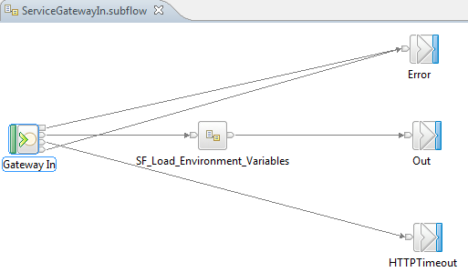
IIB Web Service HTTP Topology
All Web Service operations are constructed from a parent message flow which first make use of a common subflow: ServiceGatewayIn.subflow.
The first node in this subflow is a SOAPInput node, used to process client SOAP messages; so that the broker operates as a SOAP Web Services provider.
By default, the SOAP nodes that you deploy to an Execution Group, all use the same embedded HTTP listener which is tied to the process.
You can allocate a specific ‘fixed’ port to an integration server’s HTTP listener.

Slide 25
IIB Web Service HTTP Topology
The default port range for incoming HTTP connections is 7800 - 7842; HTTPS is 7843 - 7884.
You can fix the value of the TCP/IP port number on which each Execution Group’s embedded listener creates a server socket and awaits for incoming connections.
EM2 Day 1 Deployment Execution Group / Application | Message Flows | HTTP Port #
AccountSetup002 / AccountSetup_v2_CreateArrangementDetails, AccountSetup_v2_GenerateAccountNumbers AccountSetup_v2_OpenBusinessAccount | CreateArrangementDetails, GenerateAccountNumbers, OpenBusinessAccount | 7800
AuditManager002 / AuditManager_v2_CreateAuditEvent | CreateAuditEvent | 7802
CommunicationDispatch_v3 / CommunicationDispatch_v3_GenerateCommunicationDetails | GenerateCommunicationDetails | 7804
InvolvedPartyIdentification002 / InvolvedPartyIdentification_v2_RegisterChannelUser InvolvedPartyIdentification_v2_<other flows> | RegisterChannelUser, AdministerAccessToken, CreateAccessTokenTemplate,, VerifyAccessToken | 7806
ProductPortfolioMaintenance_v3 / ProductPortfolioMaintenance_v3_RetrieveProductDetails | RetrieveProductDetails, | 7808
RiskMonitoring_v3 / RiskMonitoring_v3_RequestApplicationVetting | RequestApplicationVetting | 7810

Slide 26
NBS Network Topology

Slide 27
High Level Infrastructure Architecture
Swindon
Active
Passive
LTM (F5)
LTM (F5)
nemcorbus.wip.nbsnet.co.uk:8200
DP
(Ext On-Ramp)
DP
(Ext On-Ramp)
NEM Core

Slide 28
High Level Infrastructure Architecture
NEM Core
Active
LTM (F5)
LTM (F5)
Passive
IHS
IHS
IIB
IIB
Op
SG
IIB
Op
IIB

Slide 29
High Level Infrastructure Architecture
NEM Core
Active
LTM (F5)
LTM (F5)
Passive
nemesb.wip.nbsnet.co.uk:8447
(port: 8450 for IIBV10)
IHS
IHS
IIBv9
IIBv9
Op
SG
IIBv9
IIBv9
Op

Slide 30
High Level Infrastructure Architecture
NEM Core
Active
LTM (F5)
LTM (F5)
Passive
nemesb.wip.nbsnet.co.uk:8447
IHS
IHS
IIBv9
IIBv9
Op
SG
IIBv9
IIBv9
Op

Slide 31
Service Gateway
Realisation of Gateway Patterns

Slide 32
Gateway Patterns
Common Gateway Behaviour
Service Gateways perform dynamic routing only, no transformation capabilities implemented to-date. Gateways provide ability to dynamically change consumer-producer coupling; without the need to re-build and deploy content. Gateway introduces the SOA concept of loose coupling between consumers and producers. The consumer identifies itself (service header V2 gatewayInfo complex type). Based on this identification the provider service instance (version) is targeted.

Slide 33
Gateway Patterns
Gateway Deployment Roll Out Policy
Wherever a release creates a new ESB service operation or BPM process, an ESB implemented routing service gateway needs to be built; which sits in front of it. Wherever a release changes an existing ESB service operation or BPM process and no gateway is already in place, again an ESB service gateway needs to be built. Wherever a release changes an existing ESB service operation or BPM process and a gateway is already in place, consumers of the changed service or process need to target the gateway and its associated routing information needs to be updated with the appropriate routing decisions.

Slide 34
NEM Service Header V2 Change
To provide routing guidance for a gateway, the NEM service header has been uplifted to a new version. The V2 header now contains an optional complex type: “gatewayInfo”. This object contains the following fields:
gatewayInfo.virtualEnvironment
This holds a string indicating the release, so for EM2 Day 2 this should always be ‘EM2DayTwo’. Note*: no spaces are allowed in the string.
This field helps to manage a ‘snapshot’ view of all the service operations being changed or created in a release. This value is provided by channel applications outside of NEM and will flow with the request message all the way down the NEM stack.
It is set once by the channel and should never be changed within a release. This will be the case for all environments; including production. Hence, to be clear, it is also used in production.

Slide 35
NEM Service Header V2 Change
gatewayInfo.schemaVersion
This holds a string indicating the major and minor version of a service operation the calling consumer is working against e.g. ‘3.1’.
This value is set first by the channel application. It is then changed in each service visited within the NEM; where one service interacts with another.
Each consumer-provider interaction where the request message travels across, the calling consumer service must first overwrite this value with the required major-minor version of the provider service they expect to call (work against).
This field is populated for all service request calls and is again used across all environments including production.

Slide 36
Gateway Patterns
There are currently two patterns with regards to the implementation of the service gateway:
REST Gateway (EDB/OB R2) | SOAP MQ/HTTP Gateway (EM2D2)
One pattern instance per REST API Manages all traffic for the API, for all versions of its swagger specification and individually managed REST operations. For ESB hosted endpoints, no extra network hop is required via the IBM HTTP Server. | One pattern instance per SOAP service operation. Manages all traffic, for all major/minor versions of an individual operation. For ESB hosted HTTP endpoints, an extra network hop is required via the IBM HTTP Server.

Slide 37
REST Service Gateway Design
n applications (per minor version)
1 swagger (per minor version)
n endpoints (per swagger)
Application: Account_SG
Local IIB calls
Operation and Version Router
/nem/accounts/*
Applications are the deployable units
Routing of
GET /nem/accounts/v2/1234/beneficiaries
schemaVersion = 2.0
Application
Application
Application
Accounts_V1_0_GetBeneficiaries
(callable flow)
Accounts_V1_1_GetBeneficiaries
(callable flow)
Accounts_V2_0_GetBeneficiaries
(callable flow)
Application
Application
Application
Accounts_V1_0_GetStandingOrders
(callable flow)
Accounts_V1_1_GetStandingOrders
(callable flow)
Accounts_V2_0_GetStandingOrders
(callable flow)
Application
Application
Application
Accounts_V1_0_GetProduct
(callable flow)
Accounts_V1_1_GetProduct
(callable flow)
Accounts_V2_0_GetProduct
(callable flow)
Temporary co-existence of two minor versions (to enable cut-over)

Slide 38
SOAP over MQ Service Gateway Design
Service Gateway Queue:
GEN_COMM_DETAILS_SG.ESB.FNF.O
Application: CommunicationDispatch_
GenerateCommunicationDetails_SG
1 application (per minor version)
1 wsdl (per minor version)
1 endpoint (per wsdl)
Local IIB calls
Applications are the deployable units
Version Router
gatewayInfo.schemaVersion = *
Routing of
schemaVersion = 3.1
Provider Queue: GEN_COMM_DETAILS_V3.1.ESB.FNF.O
Application
Application
CD_v3_0_GenerateCommunicationDetails
(soap over mq flow)
CD_v3_1_GenerateCommunicationDetails
(soap over mq flow)
Temporary co-existence of two minor versions (to enable cut-over)

Slide 39
SOAP over HTTP Service Gateway Design
1 application (per minor version)
1 wsdl (per minor version)
1 endpoint (per wsdl)
Application: ProductPortfolioMaintenance_ RetrieveProductDetails_SG
IIB HTTP calls via IHS
Version Router
gatewayInfo.schemaVersion = *
Applications are the deployable units
Routing of
schemaVersion = 3.1
https://nemesb.wip.nbsnet.co.uk:8447/
ProductPortfolioMaintenance_v3_1_RetrieveProductDetails
Application
Application
PPM_v3_0_RetrieveProductDetails
(soap over http flow)
PPM_v3_1_RetrieveProductDetails
(soap over http flow)
Temporary co-existence of two minor versions (to enable cut-over)

Slide 40
SOAP over HTTP Service Gateway
DataPower
On Ramp
8200
Default
Domain
nemcorbus.wip.nbsnet.co.uk:8200/ProductPortfolioMaintenance_v3_RetrieveProductDetails_SG
ESB.IHS
8447
LTM
(F5)
nemesb.wip.nbsnet.co.uk:8447/
PPM_RetrieveProductDetails_SG
<ESB>:18025/ProductPortfolioMaintenance_RetrieveProductDetails_SG
18025
18024
PPM_RetrieveProductDetails_SG
ESB
PPM_V3_1_
RetrieveProductDetails
PPM_V3_0_
RetrieveProductDetails
Lookup
&
Route
EG01
ProductPortfolioMaintenance_v3_001

Slide 41
SOAP over HTTP Service Gateway
DataPower
On Ramp
8200
Default
Domain
nemcorbus.wip.nbsnet.co.uk:8200/ProductPortfolioMaintenance_RetrieveProductDetails_SG
ESB.IHS
8447
LTM
(F5)
nemesb.wip.nbsnet.co.uk:8447/
PPM_3_0_RetrieveProductDetails
<ESB>:18024/PPM_V3_0_RetrieveProductDetails
18024
PPM_RetrieveProductDetails_SG
ESB
serviceHeader.gatewayInfo = [{VE=EM2D1}, {ScmV=3.0}]
PPM_V3_1_
RetrieveProductDetails
PPM_V3_0_
RetrieveProductDetails
Lookup
&
Route
EG01
ProductPortfolioMaintenance_v3_001

Slide 42
SOAP over HTTP Service Gateway
DataPower
On Ramp
8200
Default
Domain
nemcorbus.wip.nbsnet.co.uk:8200/ProductPortfolioMaintenance_RetrieveProductDetails_SG
ESB.IHS
8447
LTM
(F5)
nemesb.wip.nbsnet.co.uk:8447/
PPM_3_1_RetrieveProductDetails
<ESB>:18025/PPM_V3_1_RetrieveProductDetails
18025
PPM_RetrieveProductDetails_SG
ESB
serviceHeader.gatewayInfo = [{VE=EM2D2}, {ScmV=3.1}]
PPM_V3_1_
RetrieveProductDetails
PPM_V3_0_
RetrieveProductDetails
Lookup
&
Route
EG01
ProductPortfolioMaintenance_v3_001

Slide 43
Service Gateway
Routing Logic

Slide 44
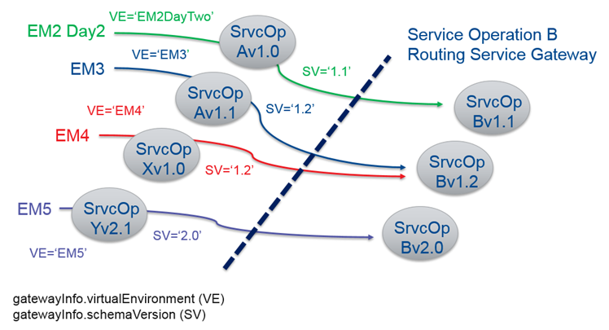
Routing Consumers Through Gateway: Service ‘XYZ’ Operation B
As service operation B evolves over time it will have new variants of itself developed by future programme releases and these too will sit behind the same routing gateway. Consider the diagram below which illustrates this policy and highlights the role played by the new V2 service header complex type: gatewayInfo.

Slide 45
Standard Routing Logic Common to all Service Gateways
The gateway routing logic needs to be as flexible as possible to ensure the widest variety of services, across releases, can consume an operation via its gateway; with minimal change enforced on such consumers to achieve this.
Specifically, we need to cater for pre-gateway services working with service header v1 or additional newer services working with v2; where in the latter case a virtual environment for a service has not been registered with the gateway, via its mapping table, or the consumer fails to provide this value. Similar flexibility equally applies to how we manage routing based on the schema version field.
Service Header Test | Description
IF gatewayInfo field not present then old consumer i.e. pre-gateway THEN Cache Query = 'DEFAULT.serviceName.operationName. DEFAULT ' | This provides a routing option for pre-gateway consumers.
IF gatewayInfo.virtualEnvironment field not present or set, but schemaVersion set THEN Cache Query = ‘DEFAULT.serviceName.operationName.schemaVersion' | This provides a routing option for services not associated to a given release. Catch build error.
IF gatewayInfo.virtualEnvironment field set but schemaVersion not present or set THEN Cache Query = 'virtualEnvironment.serviceName.operationName. DEFAULT ' | This provides a routing option where we don't wish to force all gateway consumers, within a given release, to indicate the operation version they wish to work against. Catch build error.
IF gatewayInfo.virtualEnvironment field set and schemaVersion set THEN Cache Query = ' virtualEnvironment.serviceName.operationName.schemaVersion' | This provides multiple routing options were consumers can route, for a given release, to a specific version of an operation.
IF query generated above not found in cache THEN Throw an exception as no hit found by router | Error condition due to no hit against the cache.

Slide 46
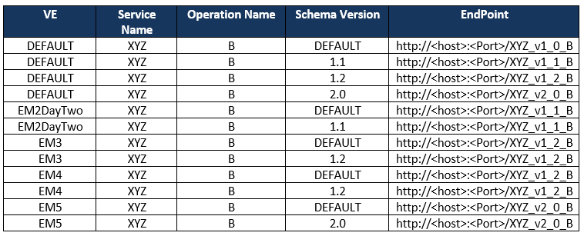
Mapping Table Rows for an Operation B Gateway
Consider the database mapping table below which is populated with all routing decision combinations, for all major/minor versions of Service Operation B; where consumers navigate to them indirectly via its gateway.
Possible combinations are based on the above standard routing logic; which is applied by all gateways.

Slide 47
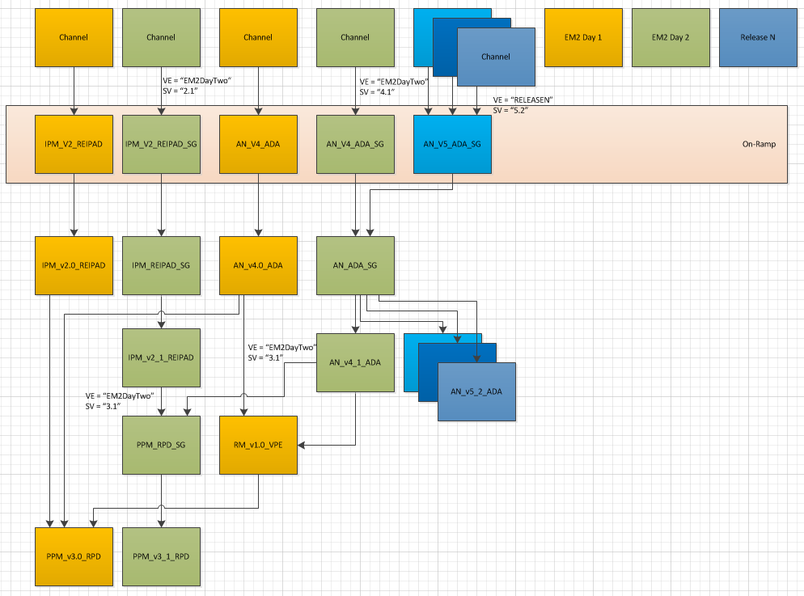
Sample EM2 Day Two Routing Topology within NEM

Slide 48
Reference Material
Service Gateway Functional Specification Document on SharePoint:
http://mynationwideteam/sites/nbs_eprise_mware_dc/Middleware%20Strategic/Shared%20Documents/Artefacts/1.%20Service%20Design/ServiceGateway/Routing_Service_Gateway_FunctionalSpecification_v0.1.doc

